Slide 1
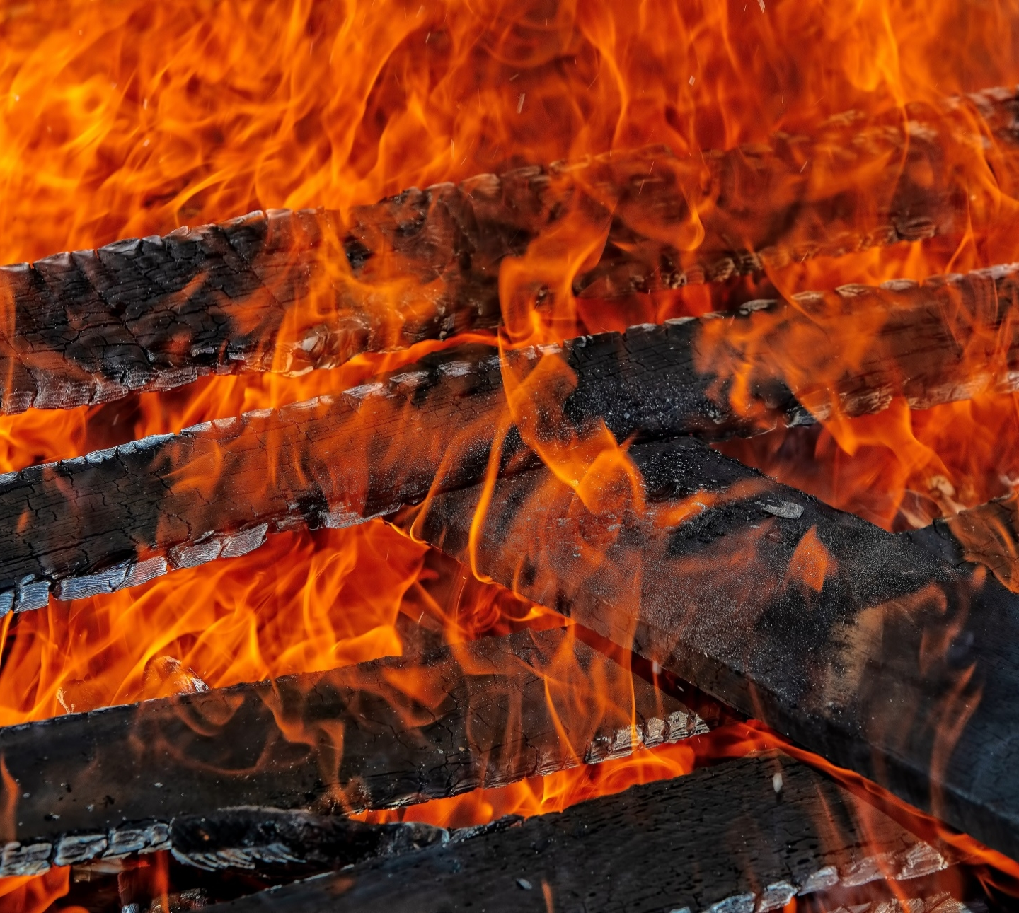

Just Scrape off the Black Bits: Using BurntToast to Display Timely Notifications
Josh King

Slide 2
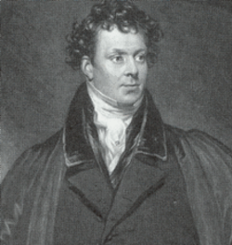
Who Am I?
Josh King
@WindosNZ

https://king.geek.nz
✶

Slide 3
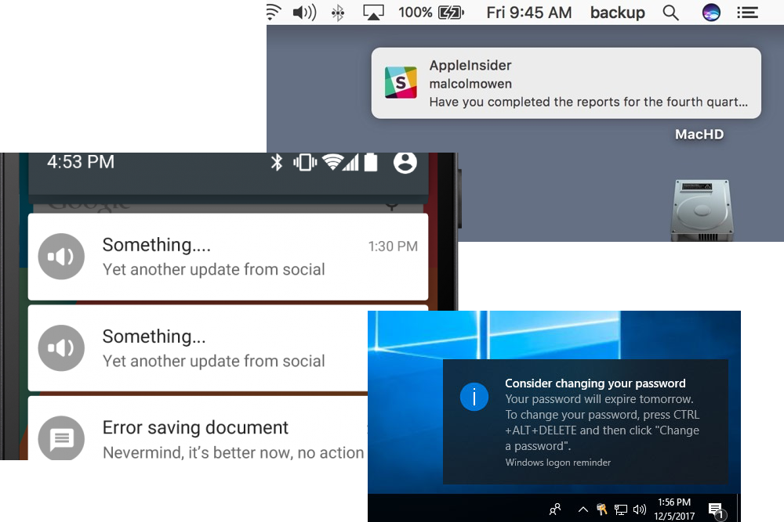
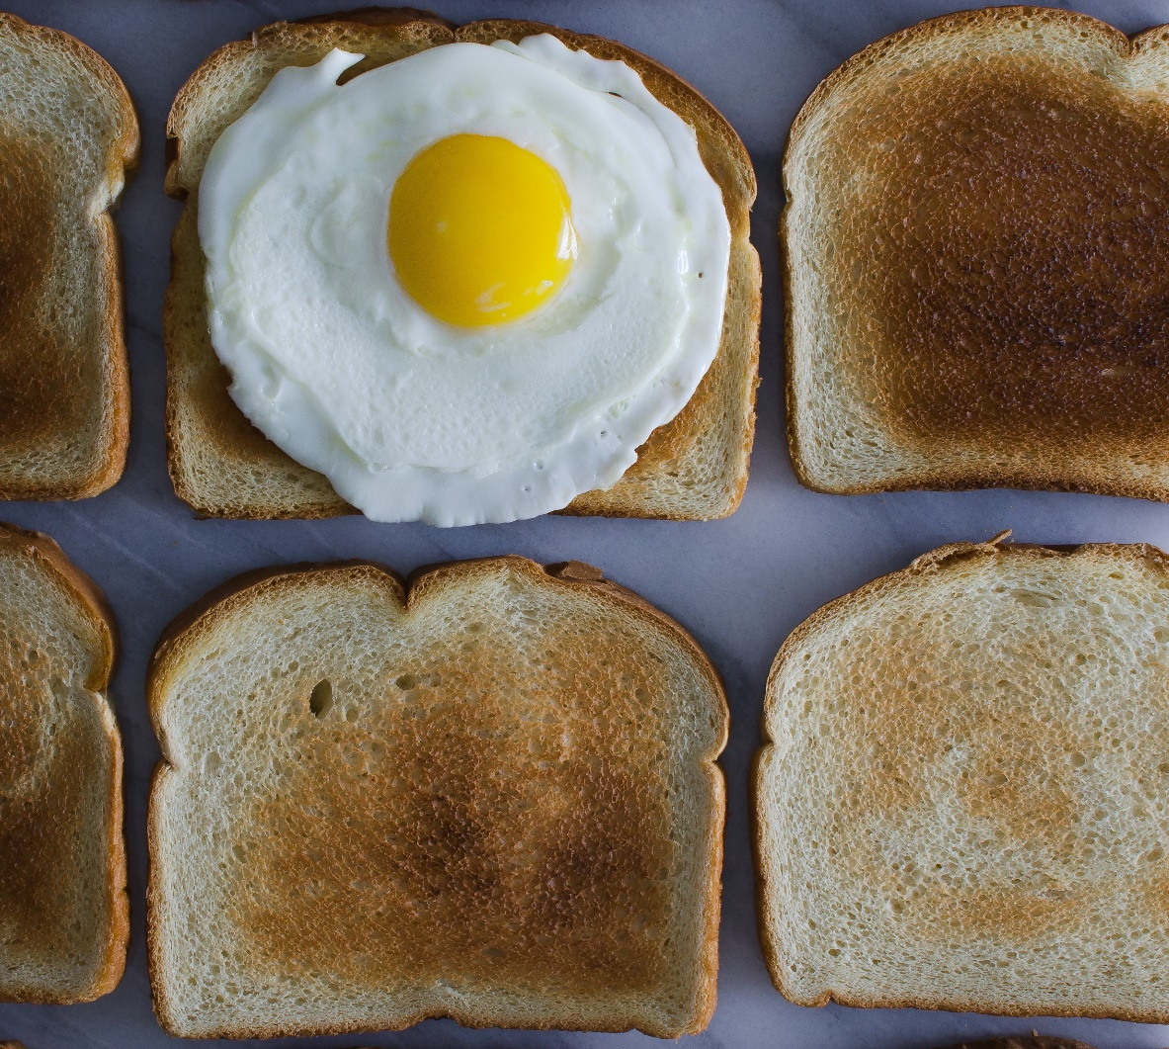
What Is Toast?

Slide 4

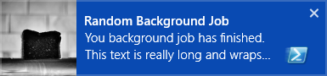

Slide 5
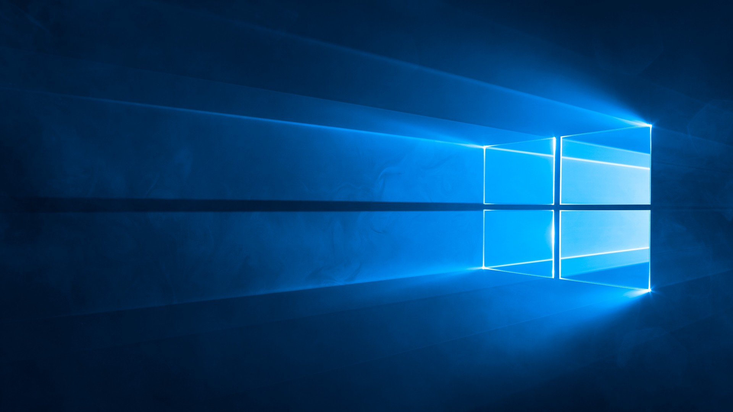
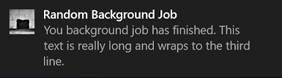

Slide 6
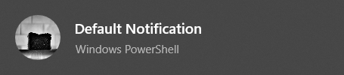
Anatomy of a Toast
It’s all XML:
<toast> <visual> <binding template="ToastGeneric"> <text>Default Notification</text> <image src="C:\Images\BurntToast.png" placement="appLogoOverride" hint-crop="circle" /> </binding> </visual> <audio src="ms-winsoundevent:Notification.Default" /> </toast>

Slide 7
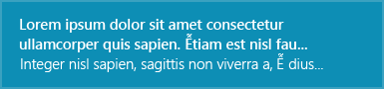
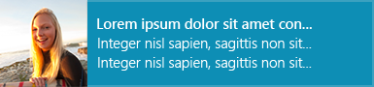
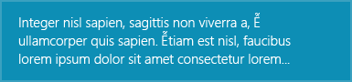
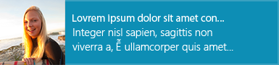
In the Beginning There Were Templates
The Docs
ToastText01 A single string wrapped across three lines of text.
ToastText03 One string of bold text wrapped across the first and second lines, one string of regular text on the third line.
ToastImageAndText02 A large image, one string of bold text on the first line, one string of regular text wrapped across the second and third lines.
ToastImageAndText04 A large image, one string of bold text on the first line, one string of regular text on the second line, one string of regular text on the third line.

Slide 8
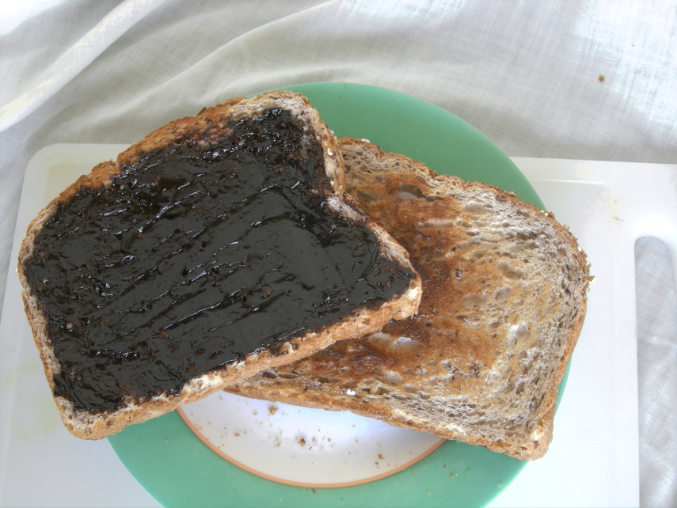
Now You Have to Be “Adaptive”…
One template to rule them all: ToastGeneric
Freedom to have your toast, your way

Slide 9
CODE TIME!

Slide 10

What’s Not Working
What’s Not Working Still Being Implemented
Events – Perform an action in code on click
Updatable toasts
Windows 10 Home Edition (Maybe?)
Updateable help

Slide 11
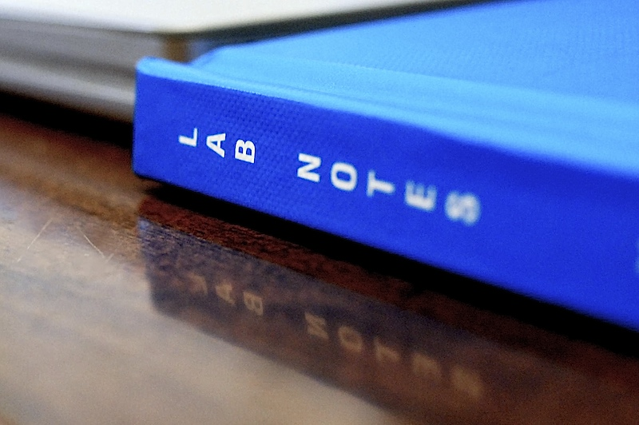
Takeaways
It’s all XML
You don’t need to touch XML
Leverage the UWP Windows Community Toolkit to roll your own
Use BurntToast
Let me know your use cases!

Slide 12
THANK YOU!
Get this slide deck from:
http://bit.ly/WindosMSPSUG
Get in touch:
@WindosNZ

